Slide 1
Using neural networks to decode EEG and read your thoughts
Building a yes/no classifier to help people with central nervous system injuries communicate

Slide 2
We are seeking to replicate and improve on the results of a recent scientific study
The original study sought to create the best yes/no binary predictor for nine participants with spinal cord injuries or major strokes.
Each participant came for two sessions several days apart
At each session they wore an array of thirty EEG electrodes and were asked to think about five different mental tasks forty times per task, for a total of 200 trials per session.
And most importantly for our purposes – they released the raw data so we can use it to try and replicate and improve on their results
Can we build a model to accurately differentiate between two of those five trial types?

Slide 3
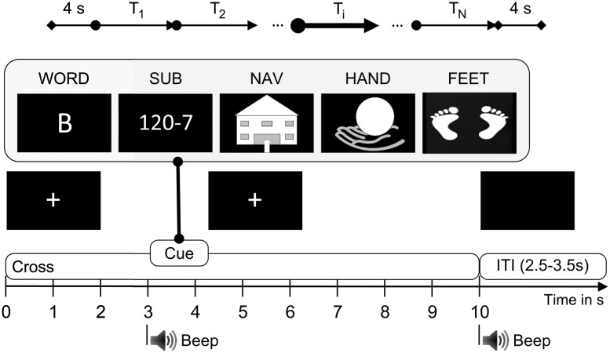
Details of the original study
Source: Reinhold Scherer, Josef Faller, Elisabeth V. C. Friedrich, Eloy Opisso, Ursula Costa, Andrea Kübler, and Gernot R. Müller-Putz:
Individually Adapted Imagery Improves Brain-Computer Interface Performance in End-Users with Disability

Slide 4
A number of signal processing methods were tried to improve signal quality
Frequency filtering (low pass and high pass filters)
Fourier transformations are very cool
Helped some, but not as much as I would have liked
Use signal-space projections (SSP) and independent component analysis (ICA)
Essentially methods for reducing dimensionality of data
Signal space projectors were fairly impactful
Baseline correction (subtract mean reading for each channel in pre-stimulus period from all signals in each trial)
Unsurprisingly didn’t help a bit
Decimate data (e.g., take every 2nd, 4th, and 8th samples)
Helped some models, hurt others
Drop trials based on peak-to-peak amplitude or lack of peak to trough amplitude
Certainly helpful, but was not able to be programmatic about choices. Room for a custom tool or new tool within MNE built on top of scipy here.
Common Spatial Patterns (CSP) to reduce dimensionality of data
By far the most impactful transformation that I tested

Slide 5
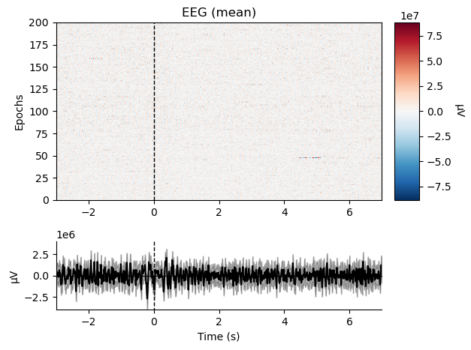
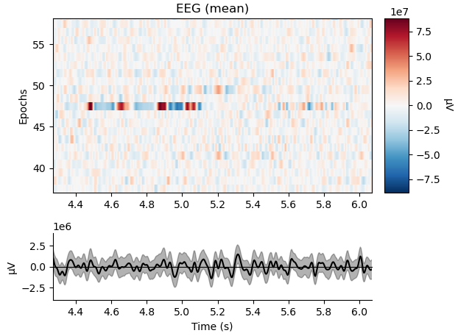
Dropping trials, visualized

Slide 6
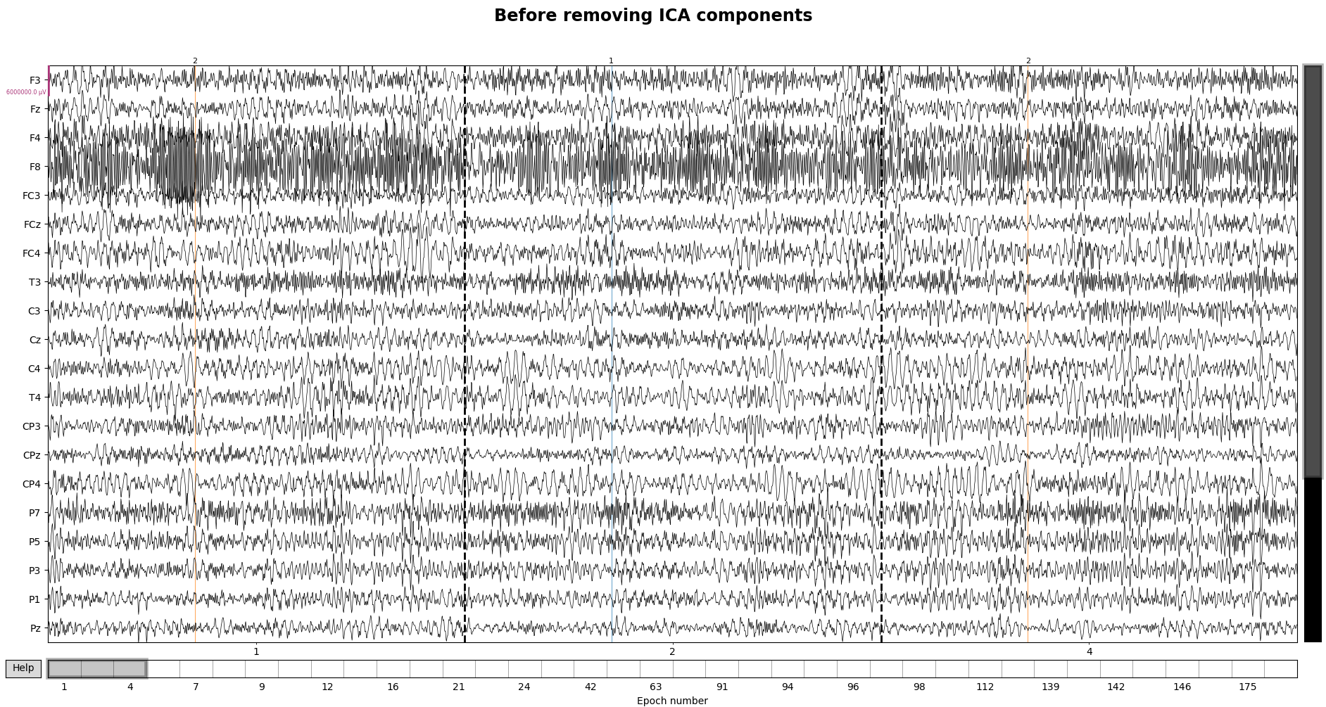
ICA visualized (1 of 2)

Slide 7
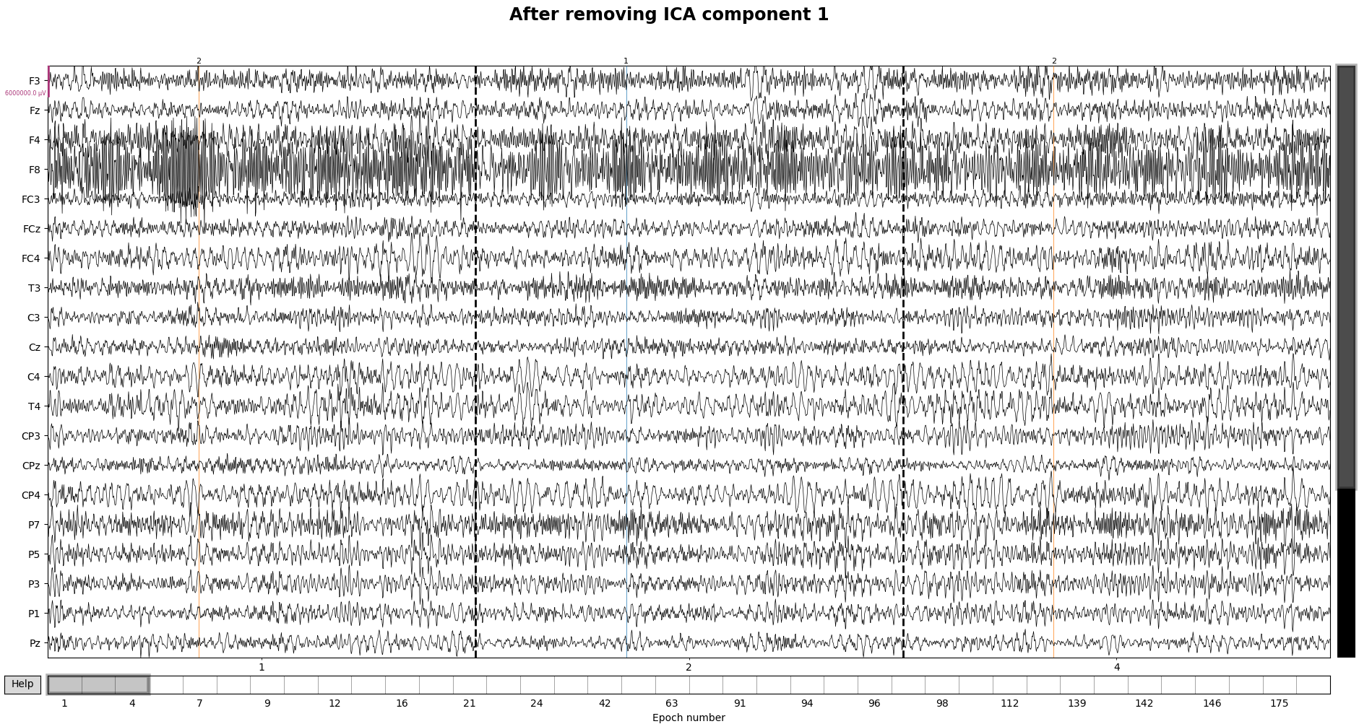
ICA visualized (1 of 2)

Slide 8
I combined several different kinds of models to try and solve the problem
Convolutional Neural Network (big filters)
Convolutional Neural Network (small filters)
LDA + Common Spatial Patterns (CSP)
Neural Network + CSP
Neural Network
Final prediction for each trial

Slide 9
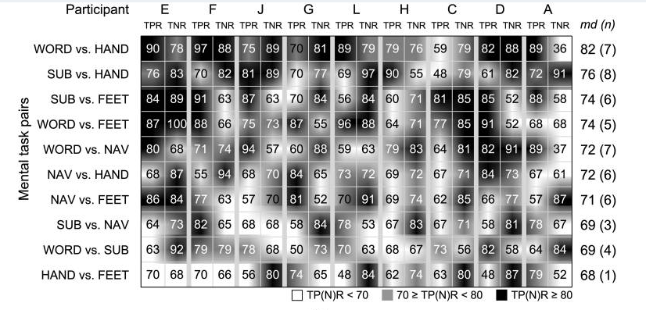
The original study achieved 80% average accuracy across the nine subjects
Source: Reinhold Scherer, Josef Faller, Elisabeth V. C. Friedrich, Eloy Opisso, Ursula Costa, Andrea Kübler, and Gernot R. Müller-Putz:
Individually Adapted Imagery Improves Brain-Computer Interface Performance in End-Users with Disability

Slide 10
Unfortunately I wasn’t able to match that accuracy on session 2 data
Subject | A |  | C |  | D |  | E |  | F |  | G |  | H |  | J |  | L
% Acc. (TPR, TNR) | 87 | 10 | 48 | 85 | 0 | 100 | 0 | 100 | 73 | 27 | 100 | 0 | 88 | 6 | 97 | 49 | 54 | 36
Extremely unbalanced positive vs negative accuracy rates show the model has not successfully adapted to the shift to session 2.
Overall average accuracy is only 55%

Slide 11
Next steps
Utilize a Reiman geometry method
Supposed to outperform CSP on EEG problems
Implement a rebiasing method
Essentially using the first few trials of session 2 to adjust the models to the shifted EEG patterns
Make CNN models more generalizable
Resample the data (e.g., instead of looking at data from 0 - 5 seconds, create three sections of data 0 – 3 1 – 4 2 - 5)
Rerun analysis with fewer dropped channels
The key to success here is more data – I should drop as little as possible

